Slide 1
EUIs Health Score Inspection
For Common Services & Project Management Groups

Slide 2
Oz Shoham
Masters Student for Social Psychology & Data Science at Ben Gurion University.
Data Practitioner at Autodesk in the past 7 months (Host: Yana Lisogurski).
Teacher Assistant for Statistics at the University.

Slide 3
Solution
Business Problem
To this date, there is no model that calculates the score by aggregation of different KPIs, which are related to EUIs
to compare between the different COEs, Groups and Teams
to track performance trend within the COEs, Groups and Teams
Why is it important for the business?
To increase our retention by customer satisfaction of our product
Health Score is a measure derived from different information regarding EUI handling in different COEs, Groups and Teams
The score ranges between 0-4, 0 being the worst possible score and 4 being the best
In our analysis we’re excluding open ticket EUIs

Slide 4
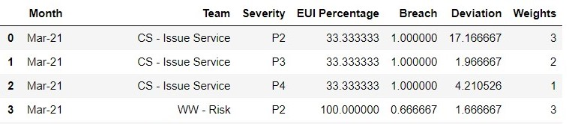
The analysis
Analysis is made up of 4 variables, for each month and each severity:
Weight – Indicates the EUI severity level with reverse score of 1-4.
Deviation – The median hours deviation from due date.
Breach – Percentage of EUIs that were out of date.
EUI Percentage – The percentage of EUIs under this specific severity level

Slide 5
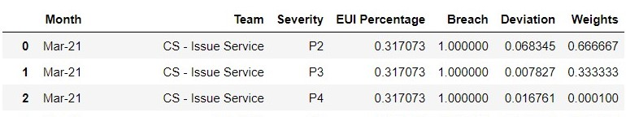
The analysis - continuation
All variables are normalized between 0 and 1 (min-max scaling)
All variables’ weight is 25%. The score calculated is being raised to the -1 power
Calculation: (0.25*(EUI Percentage+Weight+Deviation+Breach) = 0.5

Slide 6
Common Services Teams

Slide 8
Project Management Teams

Slide 12
Recommendations
Decrease The Amount of EUIs IN GENERAL
Based on analysis
Try to find common complaints &
focus on improving them.
PRIORATIZATION
Focus on the most severe (P1 & P2) EUIs first.
Then, move on to the already expired EUIs and focus on the ones that are way beyond their due date
Focus on the EUIs that are about to be expired

Slide 13
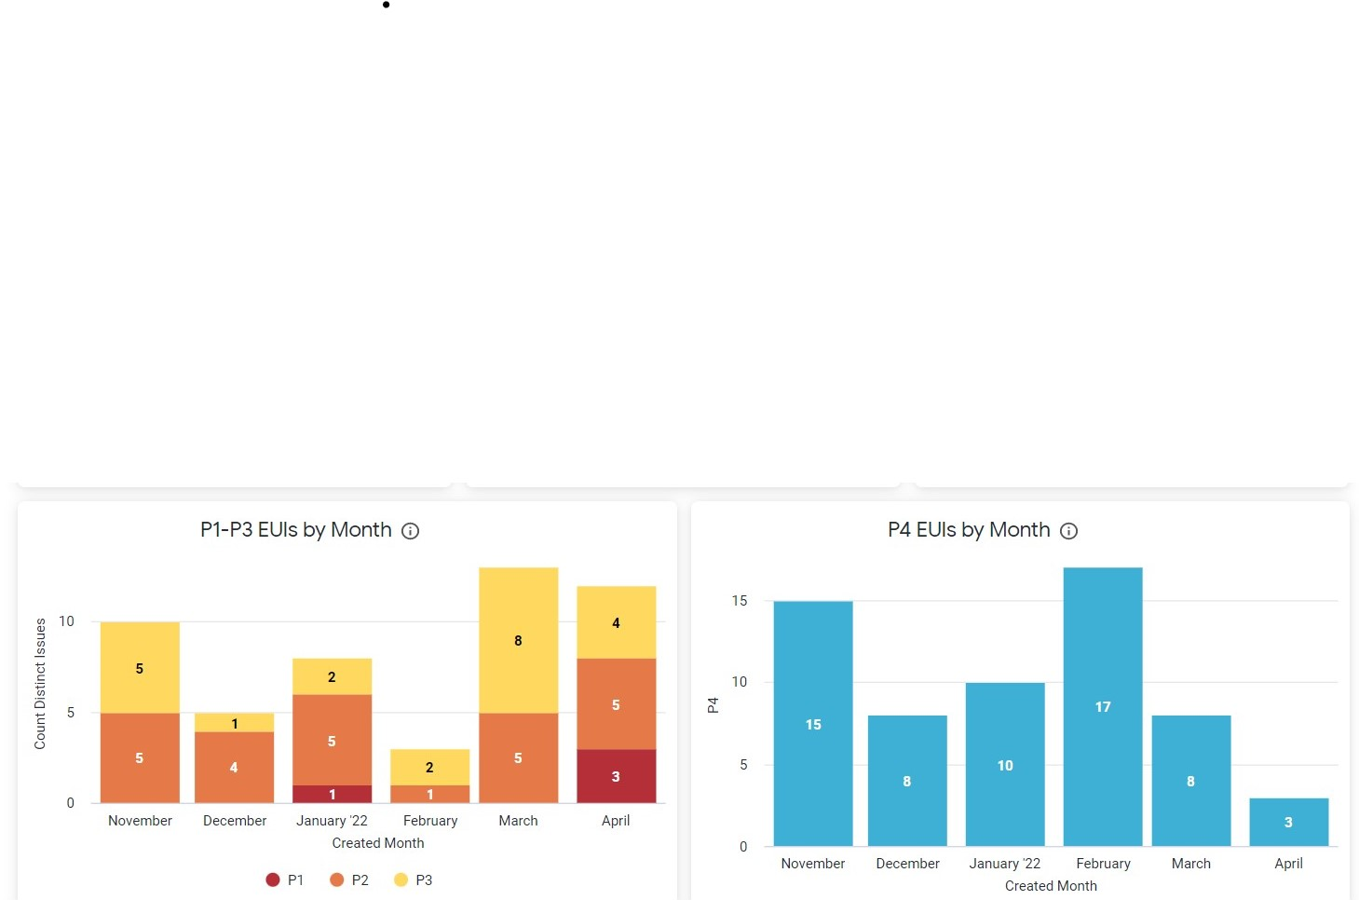
Common Services EUI Distribution by months & severity (open and closed EUIs)
I recommend merging both graphs into one all-included severity types graph

Slide 14
Use these charts to know how to prioritize your tasks. In addition, we’ll be able to add notifications before the end time arrives.
Notes:
Prioritize by P1 & P2 severity first. Then deal with your 0-10 days left EUIs. Then, move on to the higher than 55 days EUIs

Slide 15
Further Work
After a meeting we had with R&D Leads of Project Management & Common Services groups, we’ve been asked to do the following:
Filter and cultivate the Health Score measure by relevant products & platforms.
Time ‘Breach’ variable properly. Find out if we should measure it by days or hours.
Track after Customer’s Services data to gain more knowledge on the route of each EUI from the start point of the customer to the final point of reporting back.

Slide 16
THANKS!
Made by Oz Shoham

